Slide 1
Mrlc Numeracy Achievement Research Project (NAP)
MSBA
March 14, 2019
Notes:
Introductions

Slide 2
Intentions
Participants will have an initial understanding of
Numeracy Improvement in Manitoba

Slide 3
I love Math Continuum
NOPE/I Don’t get it My thing/I get it

Slide 4
Notes:
PEI was in last. Did a provincial assessment and flatlined. Teachers knew the target but not how to get there. Laura Brake working on her Masters in assessment and this started as her project. Expanded to rest of province when they saw results. – study what works. And that is what we are doing with this project.

Slide 5
mRLC Research Question
What specific factors need to be in place to ensure accelerated student achievement in Mathematics in Manitoba?

Slide 6
Overview
Pilot Started with 14 school Divisions – approximately 90 teachers
Grade 6 and 9
Expert support from PEI
Trained Numeracy Coaches
Professional learning for Principals

Slide 7
What It’s Not
A stand alone Program
Teachers becoming technicians
All About the tools
All about Assessment

Slide 8
Curriculum
Assessment
Instruction
Student Achievement
Notes:
Structure of the project:
Instruction: Teaching with High Yield Strategies and being aware of what is working in the classroom. Not louder and slower if they don’t get it.
Assessment: Need to know where yours students are and have a plan to get to where you want to go. Not enough to just assess. Need to fill in gaps at some point.
Curriculum: Had to have a good curriculum with appropriate QUESTIONS THAT WOULD CHALLENGE STUDENTS, AND BE AT A HIGH COGNITIVE LEVEL (Blooms Taxonomy). Everything had to be covered, but effectively. (pacing guide)

Slide 9
Curriculum
Curriculum
Assessment
Instruction
1. Foundational Outcomes 2. Pacing guides 3. Reach back
Notes:
The first piece of the model that we are going to discuss is the curriculum and the tools that we find that fit under the umbrella of the curriculum are 1. Foundational outcomes 2. pacing guides 3. boot camps

Slide 10
A foundational outcome has leverage, endurance, and is essential for the next level of learning. (Reeves, 2010)
Leverage: is needed to perform other outcomes
Endurance: has lasting relevance over time
Essential: is needed to continue study at the next level
All outcomes are still important to teach!

Slide 11
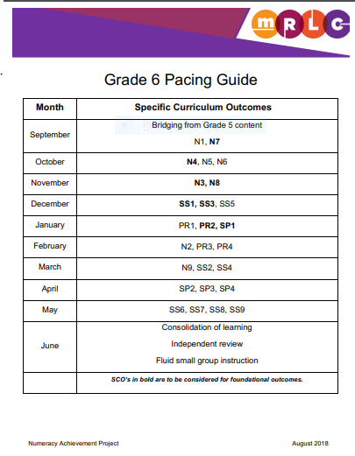
Foundational Outcomes
Front loaded
Maximum of 8
Notes:
Foundational Outcomes are Front loaded
They are the basis for additional learning.
Maximum of 8 foundational outcomes per grade level because this project is all about being sustainable
Bold lets you know which ones are foundational at a glance
-Give copy of highlighted paper of all outcomes.

Slide 12
Pacing Guide
Purpose
Informed professional judgment
Notes:
A pacing guide is front year heavy with foundational outcomes
-While we do not want to just focus on coverage, all outcomes are important to teach. If teachers keep leaving gaps, it will affect them by the time they get to Grade 9.
Experience with school who looked at their outcomes in May and what they were not going to have time to teach and it was all over the map.

Slide 13
Reachback
Focus on the foundational outcomes
Deliberate and ongoing
Still need to teach the rest of the outcomes
Some reach back can be done in the form of homework
Notes:
Daily routines like number talks
Throwback Thursdays
First 20 minutes each Monday and Friday
Homework that is not damaging homework, but home practice.

Slide 14
Instruction
Curriculum
Assessment
Instruction
1.Professional learning using High Yield Strategies
2. Conceptual & Procedural Understanding
Notes:
Nicole: This is the second part of the model
Teachers and their instructional practices make a huge difference. Not that this isn't important, but right now, this isn't our focus. Once we learn how to use the tools well, then we will focus on using high yield strategies.
Balance of conceptual understanding and procedural fluency
High yield instructional strategies

Slide 15
Two Years of Professional Learning

Slide 16
What is most important in mathematics instruction?
Conceptual Understanding?
Procedural Understanding?
https://www.edcan.ca/articles/no-more-math-wars/
Notes:
Turn and Talk.

Slide 17
Conceptual understanding is the “comprehension of mathematical concepts, operations, and relations.”
Procedural fluency is defined as “skill in carry­ing out procedures flexibly, accurately, efficiently, and appropriately.”
Notes:
Analogy: I want my surgeon to thoroughly understand what they are doing, but also be able to be accurate! Not one or the other.

Slide 18
Assessment
Curriculum
Assessment
Instruction
1. Summative baseline 2. Formative Quizzes 3. Self – Assessment
Notes:
Nicole: This is the third part of the model and remember that they all work together
4 tools we will introduce you to today:
Baseline ASsessment
Foundational Quizzes to drive next steps
Mini Quizzes
Student self assessment

Slide 19
Baseline Assessment
Will assess what is in long term memory
All outcomes should increase, not just foundational outcomes
Lets us know where we started and allows us to see where we still have to go
Notes:
Since this is summative, it is only a small piece of the puzzle. We will use some pieces to guide us, like if there were a few outcomes that stood out as issues. We may notice patterns that we need to work on, and think about how we need to do things differently in the following year– not louder and slower. We need many other tools to use formatively along the way to make in impact on student learning.

Slide 20
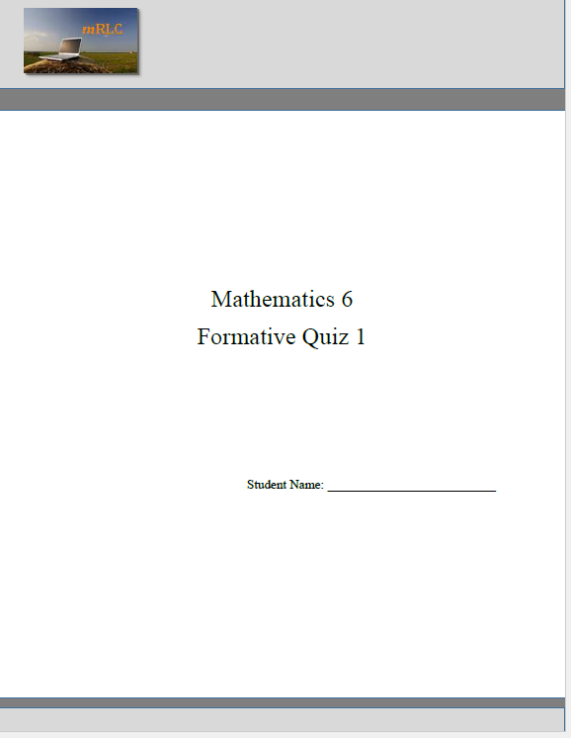
Formative Assessments
It is important for each student to know
What they are supposed to learn (target)
How they are doing in their earning (proximity to target)
What they need to learn next
To address this need, four formative assessments are created, with 10 questions per assessment.
Each question is tied to a Foundational Outcome
Notes:
Ongoing assessment - A for L September to End of Jan. will be important for students to know what the targets are and how they are doing.
In order to keep this ongoing, there are 4 quizzes that are administered during the second term after all the foundational outcomes have been addressed.

Slide 21
Notes:
Each page have a student friendly statemnt (like posters)

Slide 22
Intentional Distractors
Student 1
4 + 3 = 7
What is the perimeter of this diagram?
A 7 units
B 12 units
C 13 units
D 14 units
Student 2
4 x 3 = 12
Student 3
4 + 3 + 4 + 3 = 13
Notes:
What misconception do you think each student has when they anwer each of the incorrect responses? These are designed to uncover common errors.

Slide 23
It is never about the assessments. It is about what you do in response to the assessments.
Notes:
This is not just about the quiz results. The intention is for these to be used formatively by the teacher to improve instruction, not as a summative tool by your division or school leader.

Slide 24
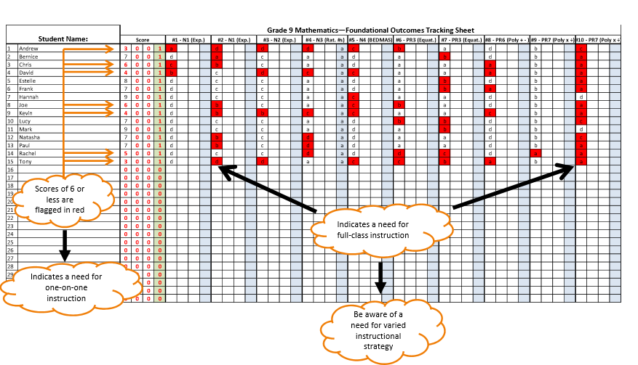
Notes:
Not students fault. We need to take ownership – not louder slower

Slide 25
Notes:
Keeps us focused fo rht enext 3 weeks

Slide 26
After each quiz….
Immediate feedback
Individual error identification process
Student self assessment and goal setting
Share results with students
Plan for corrective instruction or review

Slide 27
Student Self Assessment "Internal motivation to succeed in mathematics is one of the most important things your students can learn." "nothing is more motivating than a sense of competence." -Visible Learning for Mathematics Hattie, Fisher and Frey
Notes:
This is one of the strategies that we use in the assessment process.
That process of getting our students to become more metacognitive “thinking about their thinking” has such a huge effect size
0.69 in visible learning
And 1.44 effect is self reported grades and student expectations
Using this strategy will help your students to come further than one grade level
This helps students to break down the outcomes into manageable pieces
Students are setting their own goals
You no longer hear from students that they cant do fractions’
Instead they start to talk about elements of fractions such as troubles with converting mixed fractions to improper
You co-conconstuct strategies to support that specific learning

Slide 28
Plus Minus Action Plan
Topic
To be filled by the student after each quiz
+
-
Math skills the student has done well (be specific)
Math skills the student has yet to learn (be specific)
Action Plan
What the student will do to address items in the right column
Notes:
This is a high impact strategy
Example of specific goal on the positive
They may be able to add fractions with like denominators
Example of a specific goal under the -
This could be about mathematical conventions that they don’t yet have like their graphs don’t have appropriate labels or could be about students organization or about a concept that they need further support with
The action part is what will the student commit to in order to get better at the negative aspects of the organizer

Slide 29
Examining Student Work Together
Deconstruction
and metacognition
Notes:
This is another strategy
The deconstruction
This might be an example of a question that on a foundational outcome quiz that needs to be deconstructed
If you go though this question step by step to find the first point of error this will help them with the +- action to see where they need to go next.
Again this is a metacognitive strategy with a high effect size
We will be going further into these strategies on day two

Slide 30
Continual Learning
Ongoing streams of information and feedback among students and educators
Practices that are research-based and informed by evidence
Gradual release
What is done in response to an assessment is what makes it formative
Curriculum
Assessment
Instruction
Notes:
Add triangle again to give overview
Nicole: This whole project is about continual learning.
We are talking about looking deeply into the curriculum
Looking at how to use assessment to improve student learning
And choosing high yield instructional strategies

Slide 31
Challenges

Slide 32
Changes in teacher assignments
Leaves/term teachers
New teachers
Misconceptions
Sharing materials
Too much too soon – need to slow down to hurry up

Slide 33
Successes

Slide 34
Teacher confidence
Entire curriculum being taught
Students are able to use assessment rich practices
More focus on conceptual understanding
We all know where we are going and how we are getting there

Slide 35
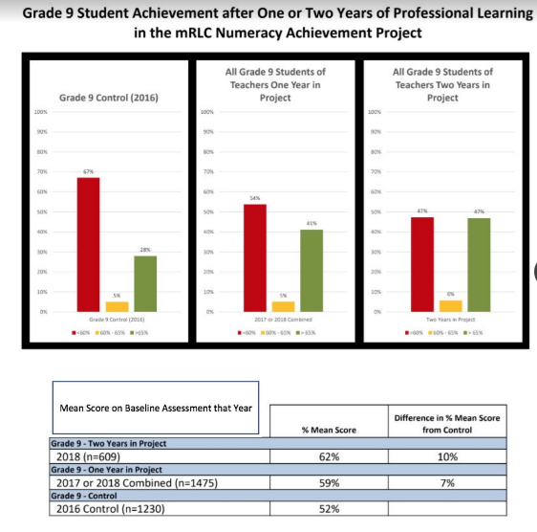

Slide 36
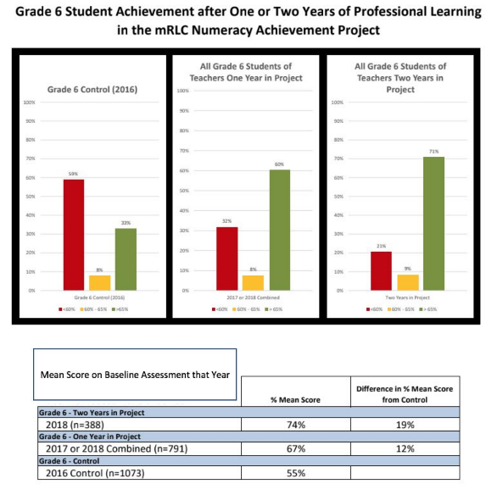

Slide 37
Current Engagement in the Implementation Phase
Divisions: 23
Schools:185
Teachers: 283
Numeracy Coaches/Leads: 49

Slide 38
Website : mrlc.ca complete report
Contact: esutherland@shaw.ca

